Slide 1
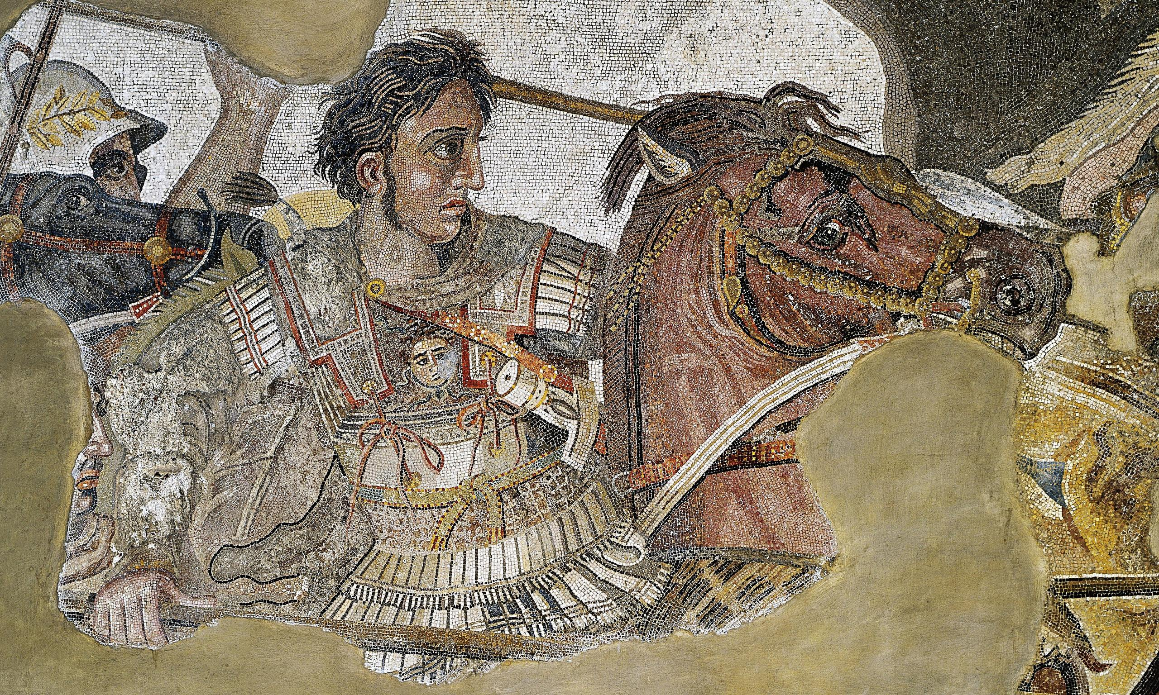
ATG - Review
Goal/s:
Review the Methods/aims of ATG
Week 2 Lesson 1 – unit 2
Ms Barrie

Slide 2
Overview of ATG – Week 1 and 2
Tuesday | Wednesday | Thursday | Friday
Poster | ATG - Legacy | SUMMARY Early Life | SUMMARY Key Battles
SUMMARY Methods/Aims | SUMMARY Impacts | SUMMARY Challenges | SUMMARY Legacy

Slide 3
ATG’s Methods/Aims
Summary topic Three

Slide 4
Class Discussion
What do you already know about ATG’s Methods/Aims?
Think about:
Battle Strategies
Goals
FILL IN YOUR MIND MAP

Slide 5
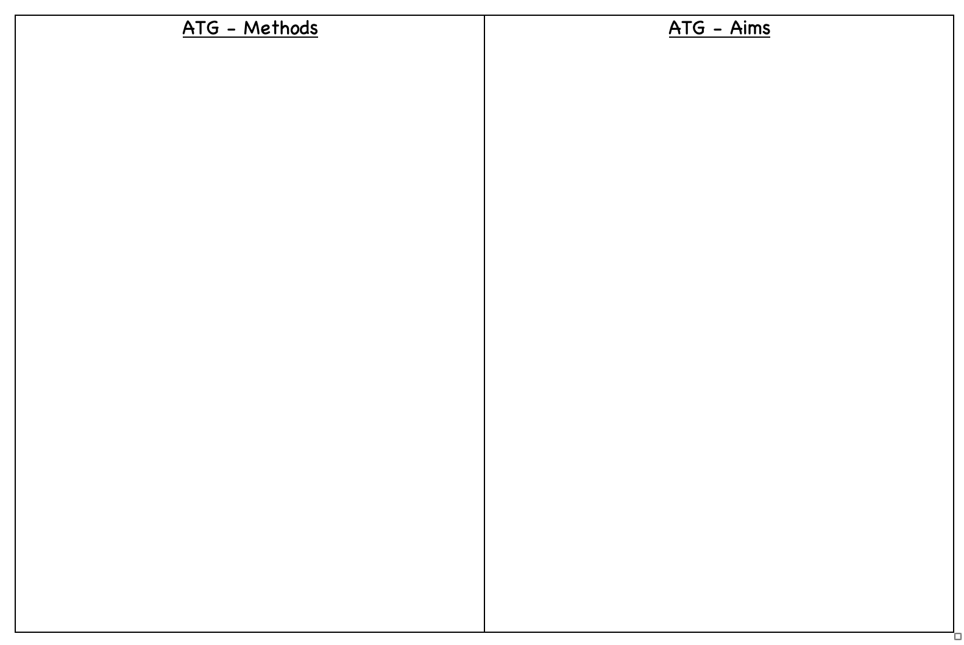
Alexander the Great – Research
Research atg’s methods and aims
Dot-point in the table

